Slide 1
Money, prices and Inflation

Slide 2
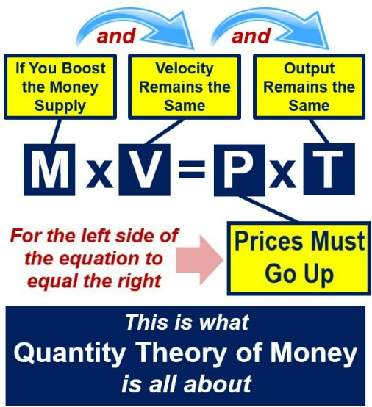
How Money Supply is Related with Prices?
Quantity Theory of Money
According to Quantity Theory of Money (QTM),
There is a direct and proportionate relationship between the quantity of money and general price level.
There is an inverse proportionate relationship
between the quantity of money and the value of
money.
Assumptions of the theory:
Trade and business activities remain constant.
Supply of credit money remains constant.
Velocity of money remains constant.
The economy is at full employment.
Notes:
What is Quantity Theory of Money?
Quantity Theory of Money is the oldest theory for determining the value of money. It was proposed by French economist Jean Bodin in 1566. It was further elaborated upon by the Italian economist Davanzatti in 1588, the English economists John Locke in 1691, and David Hume in 1752. In the twentieth century, economists such as Irving Fisher, Marshall, Pigou, Robertson, and others addressed the theory extensively. Professor Milton Friedman has put forward Modern Quantity Theory.
According to the quantity theory of money, the average price of transactions in an economy is proportional to the nominal quantity of money in circulation. The theory states that as the quantity of money price level rises, the value of money decreases.
According to Fisher, money is demanded as a transaction motive. (The value of money, like the value of any other item, is determined by the supply and demand for money. As a result, the value of money or price level is decided when the demand for money is equal to the supply of money.)
According to this theory, the demand for money is only created to pay for the existing supply of transactions. When the supply of money increases, people come to possess more money than is required to pay for current transactions. They make an attempt to spend this increased quantity of money. Hence, demand for goods rises, but due to full employment and a fixed supply of transactions, there is no increase in the production of goods, but rather a rise in prices. When prices rise, the value of transactions rises as well, which ultimately leads to an increase in the demand for money. This process continues until the demand for money equals the supply of money.
Demand for Money (PT) = Supply of Money (MV)
This equation is known as the Cash Transactions Equation and can also be expressed as:
Here, M= Money in circulation
V= Velocity of circulation of money
T= Total volume of transactions or trade transactions
P= Price level
This equation indicates that the price level is determined by the quantity of money. The price level changes with the quantity of money provided V and T remain constant. However, this equation only includes primary money or currency money (currency notes and coins), which is not the case in the modern economy. The modern economy also consists of banks’ demand deposits or credit money. Hence, after realising the growing importance of credit money, Fisher extended the equation of exchange to include credit money. The extended equation is as follows:
PT = MV + M’V’
or
Here, M= Money in circulation
V= Velocity of circulation of money
M’= Total Quantity of Credit Money (Bank Money)
V’= Velocity of circulation of Credit Money
T= Total volume of transactions or trade transactions
P= Price level
The above equation states that the factors responsible for the determination of price level are:
Quantity of money in circulation (M)
Velocity of circulation of money (V)
Volume of bank or credit money (M’)
Velocity of circulation of bank or credit money (V’)
Volume of trade (T)
Also, price level; i.e., P is directly related to M, V, M’, and V’, and is inversely related to T.
Assumptions of Fisher’s Equation of Exchange
Quantity Theory of Money is based on the following assumptions:
1. Constant Velocity, also known as Constant V and V’: The velocity of currency (V) and the velocity of credit money or bank money (V’) are considered to be constant.
2. Full Employment: The quantity theory of money assumes that the economy is currently at full employment situation.
3. Constant Trade Transactions: Due to the full employment condition, Fisher believed that trade transactions (T); i.e., the volume of goods, services, and securities, would remain constant during a specific period.
4. M and M’ have a Constant Proportion: The theory assumes that any change in the quantity of bank money is proportional to any change in the quantity of currency (M). When the quantity of currency increases, there is a proportionate rise in the amount of bank money. On the contrary, when the quantity of the currency falls, the value of bank money also decreases, because people withdraw their bank deposits. As a result, the quantity of bank money reduces.
5. Quantity of Money is an Active Factor: Fisher has only included the quantity of money; i.e., money which is transactional and thus active. It does not include deposits and money held in reserve.
6. Price level is a Passive Factor: Fisher assumed that the price level is a passive factor. It is governed by the other factors of the equation but does not govern them.
7. Long Period: Fisher’s Theory is based on the assumption of a long period. According to this theory, the quantity of money in circulation and the level of prices are properly coordinated over time.

Slide 3
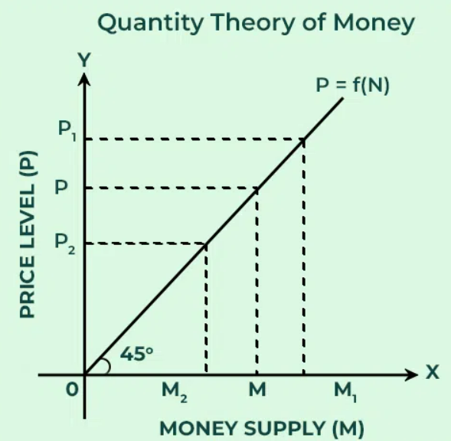
Notes:
In the above graph, when the money supply is doubled; i.e., from OM to OM₁, the price level is also doubled from OP to OP₁ and when the money supply is halved; i.e., from OM to OM₂, the price level is also halved from OP to OP₂. Besides, the price curve P = f(M) is a 45° line and has a direct proportional relationship between the money supply and the price level.
Thus, the basic proposition established by Fisher in the equation of exchange states that the price level of the money value is a function of the money supply if V, M’, V’, and T remain constant. If these things remain constant, then the change in P will be in direct proportion to M.

Slide 4
Limitations of Quantity Theory of Money
Unrealistic Assumptions
Variables are not Independent
Applicable only in case of Full Employment
Ignores the impact of Non-Monetary Factors
Static theory
Notes:
1. Unrealistic Assumptions:
It is based on the unrealistic assumption that changes in money supply are the only factors that affect the price level. The other factors in the equation, such as V and T remain, are constant and do not affect the price level. These factors are never constant in real life, and a change in one will result in a change in the price level. One of the key assumptions of the QTM is that the velocity of money remains constant over time. However, in reality, the velocity of money can fluctuate due to changes in consumer behavior, financial innovations, or shifts in economic conditions. For example, during periods of economic uncertainty, people may hold onto cash or reduce spending, leading to a decrease in the velocity of money.
Total volume of trade or transactions (T) is also assumed to be constant and is not affected by changes in the quantity of money. T is viewed as independently determined by factors like natural resources, technological development, population, etc., which are outside the equation and change slowly over time. Thus, any change in the supply of money (M) will have no effect on T. Constancy of T also means full employment of resources in the economy.
2. Variables are not Independent:
According to Fisher, M, M’, V, V’, and T are independent variables, which indicates that one does not affect the other. However, in real life, these variables are not independent of one another. Any change in one variable also affects other variables. Suppose an economy is experiencing an increase in the money supply (M) due to expansionary monetary policy. The central bank injects money into the economy by purchasing government securities or lowering interest rates, leading to an increase in the supply of money available for spending.
Fisher assumes a proportional relationship between currency money (M) and bank money (M’). Bank money depends upon the credit creation by the commercial banks which, in turn, are a function of the currency money (M). Thus, the ratio of M’ to M remains constant and the inclusion of M’ in the equation does not disturb the quantitative relation between quantity of money (M) and the price level (P).
Money Supply (M): As the money supply increases, individuals and businesses have more money to spend on goods and services.
Velocity of Money (V): Initially, the velocity of money may remain relatively stable if people continue to spend money at the same rate as before. However, as more money enters circulation, it may lead to changes in spending behavior. For example, individuals may feel wealthier due to the increased money supply and choose to spend more, leading to an increase in the velocity of money.
Volume of Transactions (T): With both the money supply and velocity of money increasing, the volume of transactions in the economy is likely to rise. More money is being spent on goods and services, leading to higher levels of economic activity.
In this example, an initial change in the money supply (M) leads to subsequent changes in the velocity of money (V) and the volume of transactions (T). While Fisher's theory suggests that these variables are independent, in reality, they are interconnected, and changes in one variable can influence the others.
3. One-sided or more Importance to Supply:
Critics claim that this theory places more emphasis on the supply of money than the demand for it, making it one-sided or giving the supply more importance. Fisher has overlooked the effect of demand on price determination with the assumption that money demand is constant. According to him, changes in the money supply also affect the level of prices. This indicates that the theory has given the exchange medium importance and ignored the function of store of value. This makes it a biased theory. The QTM focuses primarily on the demand side of the economy, emphasizing the role of the money supply in determining prices. However, it does not consider supply-side factors that can affect inflation, such as changes in production costs or resource availability. For example, an increase in oil prices due to supply disruptions can lead to cost-push inflation, independent of changes in the money supply.
4. Price level is not a Passive Factor:
Fisher assumed that the price level is a passive factor. But, this assumption is not true. Moreover, with the change in the price level, there is a change in the level of profits and volume of trade, which ultimately leads to a change in the quantity of money. An increase in price increases the quantity of money, whereas a decrease in price decreases the quantity of money.
5. Applicable only in case of Full Employment:
The quantity theory of money is only applicable in the case of Full Employment. But according to Keynes, most economies do not have a full employment situation. In such economies, increasing money supply is followed by increased production and not rising prices.
6. Fails to Explain Trade Cycles:
According to Crowther, “The quantity theory is at best an imperfect guide to the cause of the trade cycle”.
The quantity theory of money does not explain why prices rise during a boom without an increase in the money supply and why they do not rise during a depression despite an increase in the money supply. It does not explain why prices rise during a boom without an increase in the money supply and why they do not rise during a depression despite an increase in the money supply. The root cause for this is that during a recession, the velocity of money slows down; whereas, during boom, it accelerates. But, the theory considers that the velocity of money is constant. Indeed, money velocity is changing.
7. The Theory Ignores the Impact of Non-Monetary Factors:
The theory does not take into consideration the impact of non-monetary factors on the price level. The price level is influenced by various non-monetary factors such as institutional, technical, political, international, psychological, etc. These factors are not considered by the theory.
8. Measures only Cash Transactions:
According to Lord Keynes, the quantity theory of money does not measure the purchasing power of money; rather, it measures only cash transactions. Money is related to the general price level in Fisher’s equation, and the general price level is based on all types of goods and services. Both consumer and producer goods are included in the “general price level.” As a result, both producer and consumer goods are included in total transactions.
9. Inconsistent:
According to Halm, the Quantity Theory of Money is inconsistent. This theory aims to determine the quantity of money by multiplying the quantity of money that is related to a point of time or is a stock or static concept by the velocity that is related to the period of time or is a flow or dynamic concept. It is technically inconsistent to multiply two divergent factors.
10. Ignores the Effect of Rate of Interest:
The impact of interest rates on prices is ignored by theory. According to Lord Keynes, Hawtrey, and Prof. Hayek, the conclusion of the theory is that there is a direct relationship between the quantity of money and the price level, which is wrong. In fact, changes in the quantity of money affect the rate of interest, and changes in the rate of interest cause changes in the price level. However, this theory ignores the impact of interest rates. Mrs. Joan Robinson considers that changes in the quantity of money are extremely significant. Its impact on the interest rate indicates its significance. A theory of money that ignores the rate of interest is not really a theory of money.
11. Static Theory:
The Quantity Theory of Money only reveals that there is no time lag between changes in the money supply and price levels. It does not specify how long it takes to adjust the price level or what exactly happens during the process. This theory is unable to explain the dynamic elements.
12. Fails to Integrate the Theory of Value and the Theory of Money:
Lord Keynes claimed that this theory has created a wedge between the Theory of Relative Prices, or the Theory of Value, and the Theory of Absolute Prices, or the Theory of Money. Don Patinkin refers to it as a classical dichotomy. The relationship between prices and the theory of money is not explained by this theory. In reality, relative prices, which are determined by the demand for and supply of commodities, and general price levels, which are determined by the demand for and supply of money, are closely connected to each other.

Slide 5
Review Question
Question: If M = ₹1,000; M’ = 500, V = 3; V’ = 2; and T = 2,000. Calculate price level.
Notes:
P = ₹2 per unit
In the above example, if the money supply is doubled, the price level is also doubled and the value of money is halved. Similarly, when the money supply is halved, the price level us laso halved and the value of money is doubles.

Slide 6
Review Question
Question : Suppose M = Rs. 1000. M’ = Rs. 500, V = 3, V’ = 2, T = 4000 goods.

Slide 7
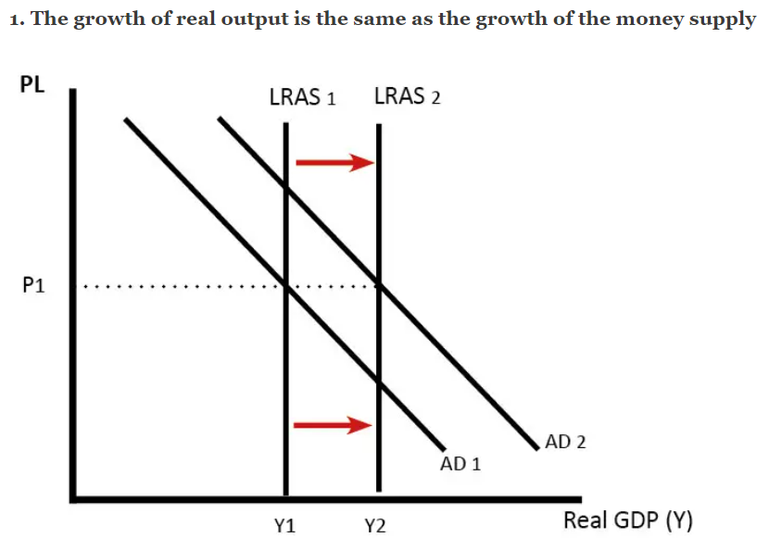
Does Money Supply Always Increase Price Level?
It is possible to increase the money supply without causing inflation. There are a few possible reasons.
Suppose the money supply increased by 4%. In a simplified model, this would lead to an increase in Aggregate Demand (AD) of 4%.
If AS (productive capacity of the economy) also increased by 4%, then the price level would be unaffected. In other words, the growth of the money supply is absorbed in the increase in real output.
Notes:
No, an increase in the money supply does not always lead to an increase in the price level. While there is a long-term relationship between changes in the money supply and changes in the price level, other factors influence the relationship, and the timing and magnitude of their effects can vary.
The Quantity Theory of Money suggests that, all else being equal, an increase in the money supply will eventually lead to an increase in the price level. However, this relationship is subject to several qualifications and assumptions:
Velocity of Money: Changes in the velocity of money, or the rate at which money changes hands in the economy, can affect the relationship between the money supply and the price level. If the velocity of money decreases, the impact of an increase in the money supply on the price level may be muted.
Real Output: Changes in real output, or the volume of goods and services produced in the economy, can influence the relationship between the money supply and the price level. If increases in the money supply lead to higher levels of investment, production, and employment, the impact on the price level may be mitigated by increased output.
Expectations and Confidence: Expectations about future inflation, economic conditions, and policy actions can influence the behavior of households, businesses, and financial markets. If individuals anticipate future inflation and adjust their behavior accordingly, the impact of changes in the money supply on the price level may be altered.
Interest Rates: Changes in interest rates, which are influenced by monetary policy and market forces, can affect the demand for money and the velocity of money. Higher interest rates may reduce the impact of increases in the money supply on the price level by reducing the demand for money and increasing the opportunity cost of holding cash.
Overall, while increases in the money supply can contribute to inflation over time, the relationship between changes in the money supply and changes in the price level is influenced by various factors, and the timing and magnitude of their effects can differ in different economic contexts.
You
Explain it with example
ChatGPT
ChatGPT
Certainly! Let's consider an example to illustrate how changes in the money supply may or may not lead to changes in the price level:
Imagine a small economy where there are only two goods: apples and oranges. Let's assume that initially, the economy is in equilibrium, with a fixed quantity of apples and oranges produced and consumed, and a fixed amount of money in circulation.
Scenario 1: Increase in Money Supply without Changes in Other Factors Suppose the central bank decides to increase the money supply by printing additional currency and injecting it into the economy. Initially, households and businesses have more money available to spend. Without any changes in the production of apples and oranges or the velocity of money, individuals may start bidding up the prices of apples and oranges, leading to an increase in the price level.
For example, if an apple previously cost $1 and an orange cost $0.50, individuals with more money may be willing to pay higher prices for these goods. As a result, the price of apples may increase to $1.20, and the price of oranges may increase to $0.60, reflecting the increased demand fueled by the additional money in circulation.
Scenario 2: Increase in Money Supply with Changes in Other Factors Now, let's consider a different scenario where the central bank increases the money supply, but there are simultaneous changes in other factors such as the velocity of money or real output.
Suppose the central bank increases the money supply by printing additional currency, but at the same time, there is a decrease in the velocity of money, meaning that money changes hands less frequently in the economy. In this case, the increase in the money supply may not lead to a proportional increase in the price level because the reduced velocity of money offsets the impact of the increased money supply on aggregate demand.
Additionally, if the increase in the money supply leads to higher investment, production, and employment, resulting in an expansion of real output, the impact on the price level may be mitigated. The increased supply of goods and services could help absorb some of the additional money in circulation, preventing excessive inflationary pressures.
In both scenarios, changes in the money supply interact with other economic factors such as the velocity of money, real output, and expectations to determine the overall impact on the price level. While increases in the money supply can contribute to inflation under certain conditions, the relationship is complex and influenced by various factors.
The money supply is the amount of money in circulation. This includes notes and coins and bank deposits.
If the government printed more money, then there would be an increase in cash in the economy. Households would have more money and so their demand for goods and services would rise. With more cash, we wish to buy more goods.
However, if the amount of goods for sale, remained the same, then firms would see a big rise in demand for this limited supply and so would respond to the higher demand by increasing prices.
Therefore, increasing the money supply faster than the growth in real output will cause inflation. The reason is that there is more money chasing the same number of goods. Therefore, the increase in monetary demand causes firms to put up prices.

Slide 8
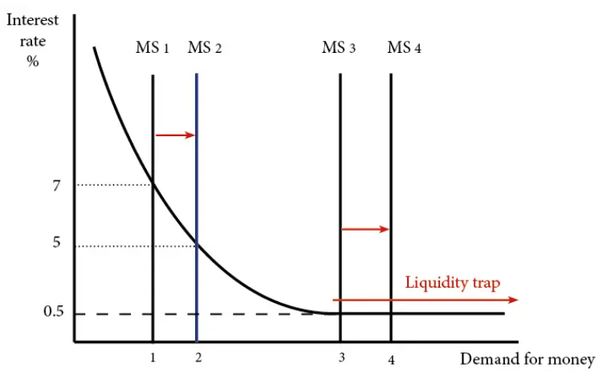
2. Increase in bank reserve ratio
3. Hard to Measure Money Supply
4. Change in Velocity of Circulation
5. Liquidity Trap
Notes:
1. In 2008/09 the Federal Reserve increased the money supply (monetary base) by over 120%. But, this did not cause inflation. In fact, the US experienced temporary deflation. The main reason is that banks increased their reserve ratio. Essentially banks received extra money from Federal Reserve, but did not want to lend it to ordinary firms and households. Therefore, the extra money supply did not reach the wider economy and there was no inflationary impact.
2. Sometimes the money supply is hard to calculate and is constantly changing. Large increases in the money supply are often just due to changes in the way people hold money. For example, an increase in credit card use may cause an increase in the broad money supply M4.
3. The quantity theory of money equation MV=PY assumes that an increase in M causes an increase in P. However, this assumes that V(velocity of circulation) is constant and Y is constant. However, in practice, it is not as simple as this equation assumes. There are often variations in the velocity of circulation.
A good example is in a recession, the stock of money may rise 5%, however, people will be making fewer transactions and therefore the velocity of circulation will fall. This is one reason why quantitative easing (increasing the money supply) did not cause inflation between 2009 and 2016.
4. In a recession, there is spare capacity in the economy. Therefore, an increase in the money supply, merely helps to get unemployed resources used in the general economy. Therefore, in the case of a recession, an increased money supply is unlikely to cause inflation.
In a liquidity trap, interest rates fall to zero but this doesn’t prevent people saving. In this situation, there is a fall in the velocity of circulation and this can cause deflation. In this situation, increasing the money supply will not necessarily cause inflation.

Slide 9
Inflation
Inflation is an increase in the overall level of prices of goods and services in the economy. At what rate the prices are increasing?
The rate at which the prices change is known as “ rate of inflation”.
When inflation goes up, there is decline in the purchasing power of the money
Notes:
Inflation refers to the sustained increase in the general price level of goods and services in an economy over a period of time. In other words, it represents the decrease in the purchasing power of money, as each unit of currency buys fewer goods and services than it did previously. It is defined as a situation where there is a sustained, unchecked increase in the general price level and a fall in the purchasing power of money. Hence, it is a condition of price rise.
The reason for price rise can be classified under two main heads : (1) Increase in demand and (2) Reduced supply.
Suppose for Rs.100, last week you bought 5 Kg. of rice. This means that the cost of 1 kg of rice was Rs. 20. This week when you approached the same shopkeeper and paid Rs.100 to get rice, he gave only 4 Kg of rice. He also explained that the price of rice has increased, and now it is Rs.25 per Kg.
This example clearly explains the fall in the purchasing power of money. For Rs. 100 you could get 5 Kg of rice before, but now only 4 Kg. So purchasing power of money was reduced. This is inflation.
And let’s calculate the rate (percentage). If the price of rice, which was Rs.20 per Kg increased to Rs.25, this corresponds to Rs.5 increase on Rs.20, ie. a 25% increase. So the inflation rate is 25%, which is a very high rate.
Inflation at the Producer Level
As of now in India, there is no index to measure inflation at the producer level. A Producer Price Index (PPI) has been proposed, but so far this type of inflation calculation has not started in India.
Inflation at Wholesale Level
This is the most popular rate calculation methodology in India. The index used to calculate wholesale inflation is known as Wholesale Price Index (WPI). This inflation rate is often known as headline inflation. WPI is released by the Ministry of Commerce and Industry.
Though RBI used WPI for most of its policy decisions before 2014. However, the WPI-based inflation calculation was not false proof. WPI shows the combined price of a commodity basket comprising 676 items. But WPI does not include services, and it neither reflects the bottlenecks between producer and wholesaler nor between wholesaler and retailer (consumer).
Hence in 2014, as part of the reforms initiated by RBI governor Raghu Ram Rajan, RBI shifted to CPI for policy decisions.
Inflation at Retail Level (Consumer Level)
The consumer often directly buys from the retailer. So the inflation experienced at retail shops is the actual reflection of the price rise in the country. It also shows the cost of living better.
In India, the index that shows the rate at the retail level is known as the Consumer Price Index (CPI). CPI is based on 260 commodities but includes certain services too. There were four Consumer Price Indices covering different socio-economic groups in the economy.
These four indices were the Consumer Price Index for Industrial Workers (CPI-IW); the Consumer Price Index for Agricultural Labourers (CPI-AL); the Consumer Price Index for Rural Labourers (CPI-RL) and the Consumer Price Index for Urban Non-Manual Employees (CPI-UNME).
CPI is now using a new series on the base 2010=100 for all India and States/UTs separately for rural, urban, and combined. The Central Statistics Office (CSO), Ministry of Statistics and Program Implementation releases Consumer Price Indices (CPI). CPI is based on retail prices and this index is used to calculate the Dearness Allowance (DA) for government employees.
Key points about inflation include:
General Price Level: Inflation affects the prices of a wide range of goods and services, not just individual items. It is typically measured using price indices, such as the Consumer Price Index (CPI) or the Producer Price Index (PPI), which track changes in the prices of various goods and services over time.
Sustained Increase: Inflation is characterized by a persistent rise in prices over an extended period, rather than short-term fluctuations. It is often expressed as an annual percentage rate, indicating the rate at which prices are rising on average.
Causes: Inflation can be caused by various factors, including:
Demand-Pull Inflation: When aggregate demand exceeds aggregate supply, leading to upward pressure on prices.
Cost-Push Inflation: When production costs, such as wages or raw materials, increase, causing firms to raise prices to maintain profitability.
Monetary Factors: Changes in the money supply, interest rates, or exchange rates can also influence inflation.
Expectations: Expectations of future inflation can influence wage and price-setting behavior, contributing to self-perpetuating inflationary cycles.
Effects: Inflation can have both positive and negative effects on an economy:
Positive Effects: Moderate inflation can stimulate consumption and investment, encourage borrowing and lending, and promote economic growth.
Negative Effects: High or volatile inflation can erode purchasing power, reduce real incomes, distort price signals, disrupt economic planning, and redistribute wealth and income in unpredictable ways.
Measuring Inflation: Inflation is measured using various price indices, as mentioned earlier. Central banks and government statistical agencies closely monitor inflation to assess economic performance, formulate monetary policy, and implement measures to stabilize prices and maintain price stability.
Overall, inflation is a complex economic phenomenon with significant implications for individuals, businesses, and policymakers. Maintaining price stability and managing inflation is a key objective of monetary policy in most economies.
Wholesale Price Index (WPI) and Consumer Price Index (CPI) are two commonly used measures that are effective in determining the inflation in the country.
WPI or Wholesale Price Index is an indicator that is used to determine the changes in the price occurring in case of goods available for wholesale in the market.
WPI is useful in calculating the change in commodity prices that occur at selected stages before it reaches retailers.
In India, WPI is used to measure the changes occurring in the price of commodities available for trading in the wholesale market.
Consumer Price Index or CPI is another price index that focuses on the sum of money that a consumer has to shell out in order to purchase a basket of goods and services over a period of time. CPI measures the price that consumers pay to retailers.
CPI is used by the Reserve Bank of India as an important tool for determining inflation, which is useful for framing the credit and monetary policy in the country.

Slide 10
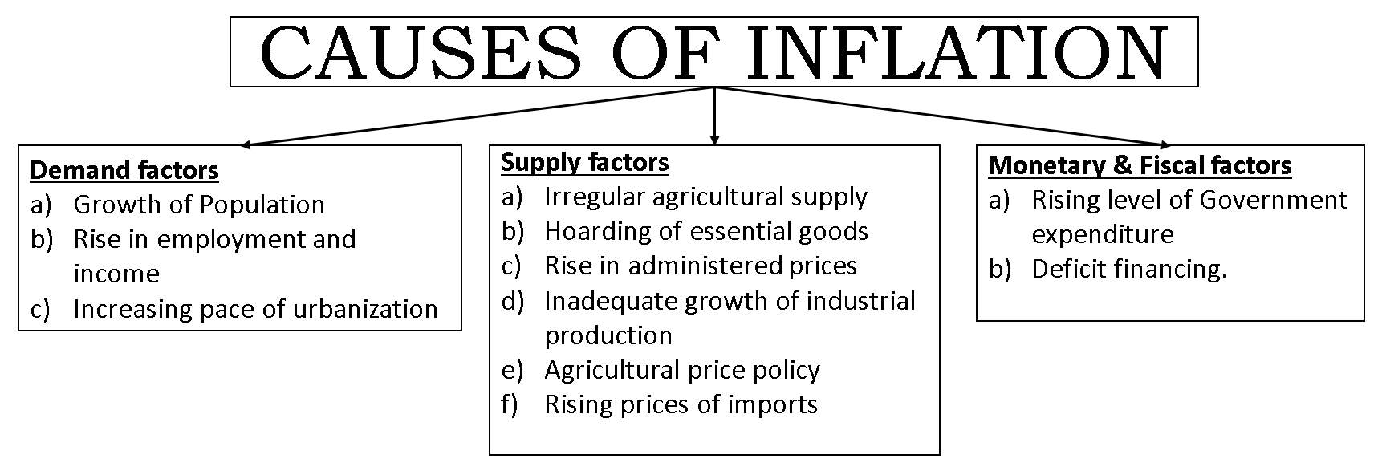
Causes of Inflation
Notes:
The following factors can be stated for the causes for inflation:
1. The mounting public expenditure is a basic reason for the excess demand in an economy. With the increase in public expenditure new projects will be implemented increasing the employment opportunities. This in turn increases the purchasing power of the people which constitutes the excess demand situation.
2. When the goods produced in the country are exported, the supply of goods for domestic consumption will go down. This in turn will create scarcity condition contributing to the rise in prices.
3. The increasing private expenditure is other reason. Usually when there is business prosperity, the investors expand the output, leading to increased demand for factors of production and increasing factor remuneration. This will increase the purchasing power of the people and it thereby causes excess demand.
4. The reduction in taxation will also add to the demand for goods as people will be left with more purchasing power.
5. The refund of public debt by the government certainly adds to the purchasing power thereby increasing the demand for goods.
6. The ever increasing population adds to the total demand for commodities causing scarcity and price rise.
7. A shortage in the supply of commodities can also lead to inflationary situation. This may be due to shortage in the factors of production. This will affect production of goods and services thereby creating shortage.
8. Sometimes, the traders also resort to large-scale hoarding for exploiting the public and making high profits. The consumers also indulge in hoarding thereby creating shortage which is artificial but adds to the price spiral.
Economists have explained the causes of inflation in many ways. Inflation may result due to variety of causes acting singly or in combination. Some terms are used to show some specific causes.
They are, Currency inflation, budgetary inflation, cost-push inflation, demand-pull inflation, profit-push inflation, excess demand inflation, speculation inflation, imported inflation, over-investment inflation, petroleum inflation, etc.
Let us discuss a few important types of inflation from the above list in detail.
1. COST-PUSH INFLATION
Inflation may be the result of rising cost of production. Industries faced with rising production costs push prices up. Increased prices will further increase production costs. Normally this cost-push is associated with wage-cost as the trade unionists claim for excessive increase in wages.
Increased cost of living will urge the trade unions to demand more wages and the wage-cost would become the production cost. Thus, the inflationary spiral develops. One example is, the enormous increase in the cost of production due to the enormous increase in the prices of petroleum fuel. It is the result of wage-cost, fuel-cost and other material costs. The economy will be caught in a mesh of inflation due to increased cost of production.
2. DEMAND-PULL INFLATION
This is the other side of cost-push theory. Inflation sets in due to persistent increase in general demand. This is only complimentary to cost-push inflation. This can be the result of cheap money policy or deficit financing or excessive foreign investment. Industries wanting to produce more goods to meet the demand will bid up the prices of their inputs. This will spread inflation to other sectors. Any excessive general demand beyond full employment will become inflationary.
3. IMPORT INFLATION
Some economies may not generate trade cycles by themselves. But they may have ups and downs through external trade or through the international trade multiplier. Higher import prices or, higher export prices or both may generate inflation in the economy.

Slide 11
Is Inflation good for the economy?
Central banks and policymakers often target a low and stable rate of inflation, typically around 2% to 3% per year, as being conducive to economic stability and growth.
Here are a few reasons why a moderate level of inflation is often considered desirable:
Avoiding Deflation
Encouraging Spending and Investment
Scope for Monetary Policy
Facilitating Economic Adjustment
Notes:
Is inflation always bad for the economy?
Though high rates are not good for the economy, mild inflation, say under 3%, may turn, at times, useful for the economy. As we hinted in the beginning, inflation can occur because of high demand too. High demand for scarce resources will automatically increase prices.
But demand for a commodity is a good sign from the industry perspective. Industries now will try to produce more commodities to reap the benefit of high prices and demand. More production will trigger GDP growth.
Global inflation is calculated by measuring the average price changes of a basket of goods and services across multiple countries. The process involves comparing the current prices of the selected items with their prices in a base year. The most common method used to calculate inflation is the Consumer Price Index (CPI), which tracks the changes in prices of goods and services consumed by households.
When the economy is not running at capacity, meaning there is unused labor or resources, inflation theoretically helps increase production. More rupees translates to more spending, which equates to more aggregated demand. More demand, in turn, triggers more production to meet that demand.
British economist John Maynard Keynes believed that some inflation was necessary to prevent the Paradox of Thrift. This paradox states that if consumer prices are allowed to fall consistently because the country is becoming too productive, consumers learn to hold off their purchases to wait for a better deal. The net effect of this paradox is to reduce aggregate demand, leading to less production, layoffs, and a faltering economy.
Economists once believed an inverse relationship existed between inflation and unemployment, and that rising unemployment could be fought with increased inflation. This relationship was defined in the famous Phillips curve. The Phillips curve was somewhat discredited in the 1970s when the U.S. experienced stagflation.
How mild Inflation can be Good
Avoiding Deflation: As mentioned earlier, deflation can be harmful to the economy, leading to reduced consumer spending, lower investment, and potentially triggering recessions. A moderate level of inflation helps prevent deflationary pressures.
Facilitating Economic Adjustment: Inflation allows relative prices to adjust more smoothly. It can help reduce real wages during downturns, making it easier for firms to adjust to changing economic conditions without resorting to significant layoffs.
Encouraging Spending and Investment: A modest level of inflation encourages consumers to spend and invest rather than hoard cash. When people expect prices to rise slightly, they're more likely to make purchases and invest their money, which can stimulate economic activity.
Supporting Monetary Policy: Central banks use interest rates to manage inflation. In a low inflation environment, central banks have more room to lower interest rates to stimulate economic activity during downturns.

Slide 12
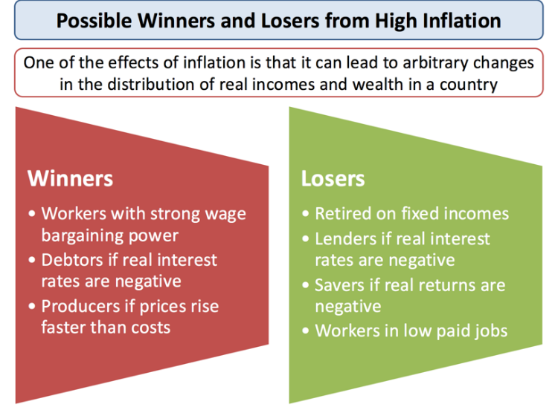
Notes:
Many governments have set their central banks a target for a low but positive rate of inflation. They believe that persistently high inflation can have damaging economic and social consequences.
Income redistribution: One risk of higher inflation is that it has a regressive effect on lower-income families and older people in society. This happen when prices for food and domestic utilities such as water and heating rises at a rapid rate
Falling real incomes: With millions of people facing a cut in their wages or at best a pay freeze, rising inflation leads to a fall in real incomes.
Negative real interest rates: If interest rates on savings accounts are lower than the rate of inflation, then people who rely on interest from their savings will be poorer. Real interest rates for millions of savers in the UK and many other countries have been negative for at least four years
Cost of borrowing: High inflation may also lead to higher borrowing costs for businesses and people needing loans and mortgages as financial markets protect themselves against rising prices and increase the cost of borrowing on short and longer-term debt. There is also pressure on the government to increase the value of the state pension and unemployment benefits and other welfare payments as the cost of living climbs higher.
Risks of wage inflation: High inflation can lead to an increase in pay claims as people look to protect their real incomes. This can lead to a rise in unit labour costs and lower profits for businesses
Business competitiveness:If one country has a much higher rate of inflation than others for a considerable period of time, this will make its exports less price competitive in world markets. Eventually this may show through in reduced export orders, lower profits and fewer jobs, and also in a worsening of a country’s trade balance. A fall in exports can trigger negative multiplier and accelerator effects on national income and employment.
Business uncertainty: High and volatile inflation is not good for business confidence partly because they cannot be sure of what their costs and prices are likely to be. This uncertainty might lead to a lower level of capital investment spending.
Overall, a high and volatile rate of inflation is widely considered to be damaging for an economy that trades in international markets. In your analysis focus on the impact on
Uncertainty / business and consumer confidence
The competitiveness of producers in international markets
The effects on the real standard of living
The possible impact on levels of income inequality
Deflation (negative inflation) can also be damaging for a country. You can read more about deflation in this study note.
Potential winners from rising inflation
Workers with strong wage bargaining power (perhaps those who belong to strong trade unions). They can protect their real incomes by bidding for higher wages.
Debtors if real interest rates on loans are negative – the real value of debt may fall.
Producers if their prices rise faster than costs leading to higher profit margins.
Wealthy groups if there is a sustained period of asset price inflation (e.g. stocks and property).
Potential losers from rising inflation
Retired people on fixed incomes – inflation cuts the real value of their pensions and other savings.
Lenders if real interest rates on loans are negative.
Savers if real returns on commercial bank deposits are negative.
Workers in low-paid jobs with little bargaining power e.g. those in the Gig Economy with no union protection.
Exporting firms may lose sales and profits if they become less competitive – eventually hitting shareholders.

Slide 13
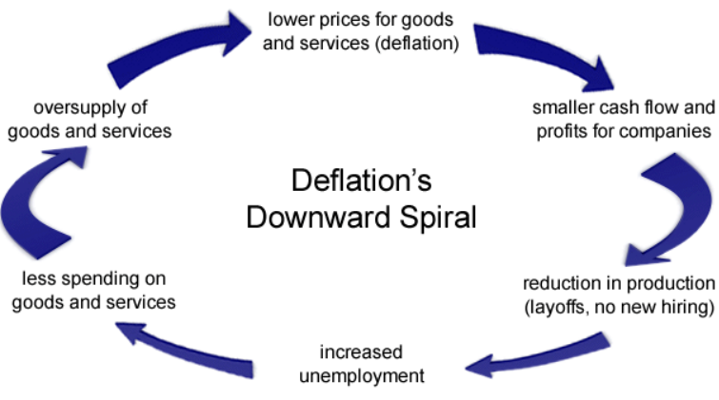
Can Inflation be Negative?
Notes:
Yes, inflation can indeed be negative, and this is referred to as deflation. Deflation occurs when the general price level of goods and services in an economy decreases over time. In other words, it's the opposite of inflation.
Deflation can happen for various reasons, such as a decrease in consumer demand, technological advancements leading to lower production costs, or a decrease in the money supply. When prices are falling, consumers may delay purchases in anticipation of even lower prices, which can further exacerbate deflationary pressures.
While moderate deflation might seem beneficial because it increases the purchasing power of money, sustained deflation can have negative consequences for the economy. It can lead to lower investment, reduced consumer spending, and even economic recessions as businesses and individuals postpone spending in anticipation of even lower prices. Central banks often aim to combat deflation by implementing monetary policies to stimulate spending and encourage moderate inflation.
Deflation is a decline in the prices of both goods and services. It often happens when there is a decreased supply of currencies and loans available within a nation.
When there is a deflation, one's purchasing power tends to go up as prices go down. So why is deflation considered to be a bad thing?
Deflation is a phenomenon that happens when the general price level of goods and services in the economy go down.
When deflation happens, most people wisely opt to hold onto their savings rather than spend them on goods and services right now, as prices will be even lower in the near future, thereby ensuring that they will be able to buy much more.
However, a deflationary period can often lead to a recession as the nation's economy slows down to a near stop.
Deflation often occurs when fewer loans are made and when the supply of a nation's currency is reduced. However, the greater productivity of workers or machines can also lead to lower overall prices.
What Causes Deflation?
There are two big causes of deflation: a decrease in demand or growth in supply. Each is tied back to the fundamental economic relationship between supply and demand. A decline in aggregate demand leads to a fall in the price of goods and services if supply does not change.
A drop in aggregate demand may be triggered by:
Monetary policy. Rising interest rates may lead people to save their cash instead of spending it and may discourage borrowing. Less spending means less demand for goods and services.
Declining confidence. Adverse economic events—such as a global pandemic—may lead to a decrease in overall demand. If people are worried about the economy or unemployment, they may spend less so they can save more.
Higher aggregate supply means that producers may have to lower their prices due to increased competition. This boost in aggregate supply may stem from a drop in production costs: If it costs less to produce goods, companies can make more of them for the same price. This can result in more supply than demand and lower prices.
Consequences of Deflation
Although it may seem helpful for the price of goods and services to fall, it can have very negative effects on the economy.
Unemployment. As prices drop, company profits decrease, and some companies may cut costs by laying off workers.
Debt. Interest rates tend to go up in periods of deflation, which makes debt more expensive. Consumers and businesses often decrease spending as a result.
Deflationary spiral. This is a domino effect caused by each overlapping piece of deflation. Falling prices may result in less production. Less production may lead to lower pay. Lower pay may result in a drop in demand. And a drop in demand may cause increasingly lower prices. And on and on. This can make a bad economic situation worse.
Why Deflation Is More Harmful Than Inflation
When prices go up and the power of the dollar goes down, the economy is experiencing inflation.
While inflation means your dollar doesn’t stretch as far, it also reduces the value of debt, so borrowers keep borrowing and debtors keep paying their bills. Modest inflation is a normal of the economic cycle—the economy typically experiences inflation of 1% to 3% per year—and a small amount is generally viewed as a sign of healthy economic growth.
Inflation is also something consumers can protect themselves against to a certain extent. Investing your money, for instance, can help your earnings grow faster than inflation, helping you retain and grow your purchasing power.
While it may seem worse for prices to rise than to fall, deflation is generally less favorable and is associated with economic contractions and recessions. A deflationary spiral may turn hard economic times into recessions and then depressions.
Protecting yourself against deflation is also a little trickier than safeguarding against inflation. Unlike with inflation, debt becomes more expensive with deflation, leading people and businesses to avoid taking it on as they try to pay off the increasingly pricy debts they already owe.
During periods of deflation, the best place for people to hold money is generally in cash investments, which don’t earn much, if any, returns. Other types of investments, like stocks, corporate bonds, and real estate investments, are riskier when there’s deflation because businesses can face very difficult times or fail entirely.
Controlling Deflation
The government has a few strategies to rein in deflation.
Boost the money supply. The Federal Reserve can buy back treasury securities to increase the supply of money. With a greater supply, each dollar is less valuable, encouraging people to spend money and raising prices.
Make borrowing easier. The Fed might ask banks to boost the amount of credit available or lower interest rates so people can borrow more. If the Fed lowers the reserve rate, which is the amount of cash commercial banks must have on hand, banks can loan out more money. This encourages spending and helps raise prices.
Manage fiscal policy. If the government bumps up public expenditures and cuts taxes, it can boost both aggregate demand and disposable income, leading to more spending and higher prices.

Slide 14
Reflation
Reflation is a fiscal or monetary policy designed to expand output, stimulate spending, and curb the effects of deflation.
The goal is to expand output, stimulate spending and curb the effects of deflation.
Policies include tax cuts, infrastructure spending, increasing the money supply, and lowering interest rates.
Notes:
Reflation vs. Inflation
It is important not to confuse reflation with inflation. Firstly, reflation is not bad. It is a period of price increases when an economy is striving to achieve full employment and growth.
Inflation, on the other hand, is often considered bad as it is characterized by rising prices during a period of full capacity. G.D.H. Cole once said, "reflation may be defined as inflation deliberately undertaken to relieve a depression."
Additionally, prices rise gradually during a period of reflation and fast during a period of inflation. In essence, reflation can be described as controlled inflation.
Reflation is an economic term referring to the deliberate policy measures aimed at stimulating economic growth and reversing deflationary trends. It involves increasing aggregate demand in the economy through various means, such as monetary policy actions by central banks or fiscal policy measures by governments.
Reflation typically occurs in response to a period of economic downturn, characterized by falling output, rising unemployment, and declining prices. During such times, policymakers may implement reflationary measures to boost spending, investment, and consumption, with the goal of revitalizing economic activity and restoring price stability.
Reflationary policies can include:
Monetary Policy: Central banks may adopt expansionary monetary policies, such as lowering interest rates, engaging in quantitative easing (buying government bonds or other securities), or providing liquidity to financial markets. These measures aim to make borrowing cheaper and encourage spending and investment.
Fiscal Policy: Governments may implement fiscal stimulus measures, such as increasing government spending on infrastructure projects, providing tax cuts or rebates, or offering direct transfers to households. These measures inject additional funds into the economy, boosting demand and supporting economic activity.
The goal of reflation is to prevent or reverse deflation (a sustained decrease in the general price level) and stimulate economic growth. However, policymakers must carefully balance reflationary measures to avoid excessive inflation or other adverse economic outcomes.
In essence, reflation is about jump-starting a sluggish economy by increasing spending and investment, with the aim of promoting recovery and returning to a path of sustainable growth.

Slide 15
Disinflation
Disinflation is a temporary slowing of the pace of price inflation. The term is used to describe occasions when the inflation rate has reduced marginally over the short term.
Unlike inflation and deflation, which refer to the direction of prices, disinflation refers to the rate of change in the rate of inflation.
A healthy amount of disinflation is necessary since it prevents the economy from overheating.
The danger that disinflation presents is when the rate of inflation falls near to zero
Notes:
Disinflation is a term used to describe a decrease in the rate of inflation, rather than a decrease in prices (which would be deflation). In other words, disinflation means that prices are still rising, but at a slower rate than before. It's a situation where the rate of inflation is declining, but prices are still increasing, albeit more slowly.
Here's an example to illustrate disinflation:
Suppose the annual inflation rate in an economy was 5% last year. This means that, on average, prices increased by 5% over the course of the year. However, in the current year, the inflation rate has decreased to 2%. Prices are still rising, but they're now increasing at a slower pace compared to the previous year.
For instance, if a loaf of bread cost $2 last year, a 5% inflation rate would mean that the price of the bread would increase by 5% to $2.10 this year. In contrast, with a 2% inflation rate this year, the price of the bread would only increase by 2% to $2.04. So, while prices are still rising, they're rising at a slower rate than before.
Disinflation is often seen as a positive development because it can help maintain price stability and prevent the harmful effects of inflation, such as eroding purchasing power and distorting economic decision-making. However, if disinflation persists and leads to deflation (a sustained decrease in the overall price level), it can pose challenges for economic growth and stability. Therefore, central banks and policymakers typically aim to achieve a moderate and stable rate of inflation through monetary and fiscal policy measures.

Slide 16
Consumer Price Index (CPI)
Consumer Price Indices (CPI) measure changes over time in general level of prices of goods and services that households acquire for the purpose of consumption. CPI is widely used as a macroeconomic indicator of inflation, as a tool by governments and central banks for inflation targeting and for monitoring price stability, and as deflators in the national accounts. CPI is also used for indexing dearness allowance to employees for increase in prices.
Base 2012=100
Released on monthly basis by the Ministry of Statistics and Programme Implementation (MOPSI)
Notes:
Inflation is calculated by measuring the changes in the cost of living, by looking at the price of a “basket of goods” and services Brits use every day.
This basket is determined based on the findings of an annual Family Expenditure Survey conducted by the Office for National Statistics (ONS). It asks volunteers to discover what people’s shopping habits are.
Then, based on these habits, the Government checks the prices of the 1,000 most common goods in the UK every month, noting the changes in the values of such items and services.
The percentage increases are then multiplied by the weighting the product in question has been given, which in turn reveals how much the price increase is affecting consumers’ budgets.
CPI stands for Consumer Price Index. It is a commonly used economic indicator that measures changes in the average prices paid by urban consumers for a basket of goods and services over time. The CPI is used to track inflation, which is the rate at which prices for goods and services rise, and it provides valuable information for assessing changes in the cost of living.

Slide 17
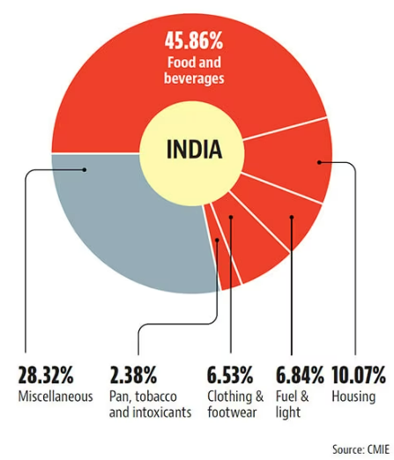
Broad Composition of India’s CPI
Notes:
Consumer Price Index in India measures price changes by comparing the cost of a fixed set of commodities over time. The set is based on the expenses of a target population over a reference period. Since the set contains commodities of constant or identical quality and quantity, the index reflects only the pure price.
The price data of goods and services are collected periodically, and the inflation levels in the economy are calculated by using the data collected from the CPI. This is further used to compute the cost of living. Not only this, but the Consumer Price Index also provides insights into how much a consumer can spend to be on par with the price change in an Indian economy.
Advantages of Consumer Price Index
Over the years, CPI have been commonly used as a macroeconomic indicator of inflation and a tool by the Central Bank and the Government to monitor price stability and target inflation. Hence, Consumer Price Index is considered one of the key economic indicators. The Reserve Bank of India and other agencies study CPI to interpret the price change of various commodities and keep a check on inflation. The advantages of the Consumer Price Index include:
Accuracy: The CPI captures price changes for a wide range of goods and services, providing a comprehensive picture of inflationary trends.
Comparability: The CPI allows for comparisons across different time periods, regions, and demographic groups, enabling meaningful analysis of price movements.
Policy formulation: The CPI serves as a vital tool for policymakers in formulating economic policies, including adjustments to wages, social benefits, and taxation.
Cost-of-living adjustments: The CPI is often used to calculate cost-of-living adjustments, ensuring that wages, pensions, and benefits keep pace with inflation.
Economic indicators: The CPI is used as a key economic indicator to assess the overall health of the economy and monitor inflationary pressures.

Slide 18
How Inflation is Calculated in India?
CPI (combined) | Base year 2012 | February 2018 | February 2019 | % change (Inflation rate 2019) Y-O-Y
Combined | 100 | 136.4 | 139.9 | 2.57%
Rural | 100 | 138.4 | 141 | 1.87%
Urban | 100 | 134 | 138.6 | 3.43%

Slide 19
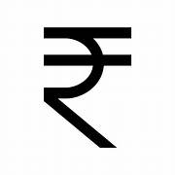

Review Question
Question: The typical household in India buys 4 kg rice, 3 kg wheat and 8 kg pulses each week. The prices of these goods in years 2015, 2016, and 2017 are given in the table below:
Year | Price of Rice | Price of Wheat | Price of Pulses
2021 | 1 | 3 | 10
2022 | 2 | 6 | 20
2023 | 3 | 6 | 25
Calculate the CPI in 2023, using 2022 as the base year.
Calculate the CPI in 2021, using 2022 as the base year.
Calculate the rate of inflation between 2021 and 2022.
Calculate the rate of inflation between 2022 and 2023.
Give a reason why the rate of inflation between 2022 and 2023 might overstate the cost of living.

Slide 20
Core vs Headline Inflation
Headline inflation refers to the change in the value of all the goods in the basket. It is measured with Consumer Price Index (CPI) in India.
Core inflation excludes fuel and food items from headline inflation.
Since the prices of food and fuel tend to fluctuate, core inflation is less volatile than headline inflation.
In developed economy, food and fuel account for 10-15% of the household’s consumption basket and in developing economies it forms 30-40% of the basket.
Therefore, headline inflation is more relevant for developing economies than developed economies.
Notes:
Core inflation is the change in the costs of goods and services but does not include those from the food and energy sectors.
Food and energy prices are exempt from this calculation because their prices can be too volatile or fluctuate wildly.
Why is it important?
Core inflation is used to determine the impact of rising prices on consumer income.
If the increase in the price index is due to temporary shocks that could soon reverse themselves, it may not require any monetary policy action.
To deal with such situations, many central banks use measures of core inflation that are designed to filter the transitory price movements.
Core inflation by eliminating the volatile components from the headline helps in identifying the underlying trend in headline inflation and is believed to predict future inflation better.
Core inflation is a convenient guide to help the central bank achieve its objective of controlling total inflation.
What is Headline Inflation?
It is the raw inflation figure reported through the Consumer Price Index (CPI).
The CPI determines inflation by calculating the prices of a fixed basket of goods.
Core inflation removes the CPI components that can exhibit large amounts of volatility from month to month.

Slide 21
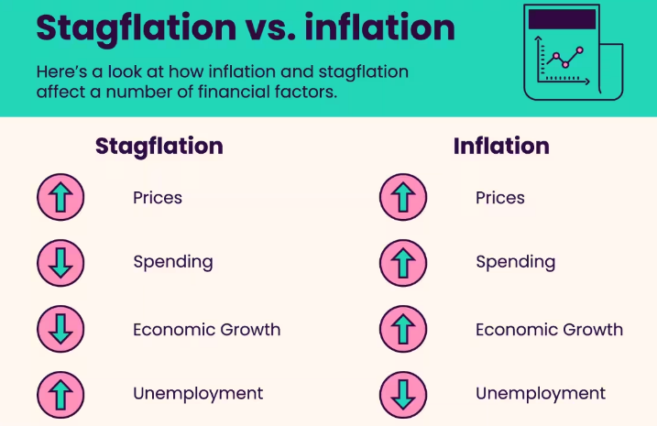
Stagflation: Stagnant + Inflation
Stagflation is an economic cycle characterized by slow growth and a high unemployment rate accompanied by inflation.
Notes:
Stagflation is an economic phenomenon that is defined by periods with considerable inflation, little to no growth, and high unemployment. Prior to the 1970s, the dominant economic theories suggested inflation nearly always increased when the unemployment rate was low and decreased when the unemployment rate was high. Economists have since had to refine their economic theories.
What Is Stagflation?
Stagflation is a term used to describe an economy experiencing significant inflation, high unemployment, and slow to no economic growth.
Periods of stagflation were prevalent in the 1970s and 1980s in most major economies. This surprised economists as the dominant economic theory of the time, Keynesian macroeconomic theory, posited that increases in inflation and unemployment couldn’t happen at the same time.
This was partly based on the Phillips Curve, an economic model that was used to argue that there was an inverse relationship between unemployment and inflation. Economists have since identified many potential factors that influence stagflation including a sudden supply shock and harmful government policies.
What Causes Stagflation?
Supply shock: A sudden disruption in the supply of critical resources, such as oil or food, can cause prices to rise while economic growth slows down. For example, a significant increase in oil prices can increase the cost of production and transportation, leading to higher prices for goods and services.
Cost-push inflation: When businesses face higher costs of production, they may pass those costs on to consumers in the form of higher prices. This can lead to a spiral of rising prices and stagnant economic growth as consumers cut back on spending.
Demand-pull inflation: A strong demand for goods and services can lead to higher prices, which can cause inflation. However, if the economy is unable to keep up with demand, it can result in stagnant growth and high inflation.
Structural issues: Structural issues such as a lack of investment in infrastructure, inadequate education, and skills training, or inefficient government policies can hinder economic growth and lead to inflation.
Monetary policy: In some cases, monetary policy can contribute to stagflation. For example, if a central bank maintains a loose monetary policy to stimulate economic growth, it can lead to inflation. However, if the economy is unable to grow, this can result in stagflation.
Stagflation Concerns in India
The COVID-19 pandemic and its impact on the Indian economy had raised fears of stagflation in India. The lockdowns during the pandemic resulted in a fall in economic growth and increasing unemployment even as the price of commodities increased due to supply constraints.
However, some economists have ruled out stagflation in the Indian economy based on the following reasons.
While the Indian economy contracted during the pandemic years, this would be only a temporary phenomenon and India is expected to grow faster in the coming years.
Though retail inflation has been quite high, core inflation – that is inflation without taking into account food and fuel – is still benign. The spike in inflation rates is likely to flatten out in the coming months.
Concerns associated with stagflation:
Double pressure:
With stalled economic growth, unemployment tends to rise and existing incomes do not rise fast enough and yet, people have to contend with rising inflation. So people find themselves pressurised from both sides as their purchasing power is reduced.
Difficulty in countering:
Stagflation characterized by low economic growth rates and high inflation rates results in an unfavourable combination and can be a dilemma for governments since most actions designed to lower inflation may raise unemployment levels, and policies designed to decrease unemployment may worsen inflation.
Why Stagflation is Bad
Reduced purchasing power: Stagflation leads to a decrease in purchasing power as prices rise, but incomes do not. This means that individuals and businesses can buy fewer goods and services, which can lead to a decline in their standard of living.
Higher unemployment: In many cases, stagflation leads to higher unemployment as businesses cut back on production and hiring in response to higher costs of production and decreased demand for their goods and services.
Economic instability: Stagflation can cause economic instability as businesses struggle to adapt to the changing economic conditions. This can lead to bankruptcies, layoffs, and other negative consequences for individuals and communities.
Limited policy options: Stagflation can limit the policy options available to governments and central banks. The traditional tools used to combat inflation, such as raising interest rates, can worsen the economic slowdown and increase unemployment. At the same time, policies that are designed to stimulate economic growth, such as increasing government spending or cutting taxes, may further fuel inflation.
Long-lasting effects: Stagflation can have long-lasting effects on the economy, particularly if it is not addressed promptly. The longer stagflation persists, the more difficult it can be to reverse its effects and restore economic growth and stability.
Possible Steps to avoid Stagflation:
Targeted monetary policy: Central banks can use targeted monetary policy tools, such as adjusting the money supply or interest rates, to address the specific causes of stagflation. For example, if stagflation is caused by supply-side factors, such as a disruption in the supply of critical resources, a central bank could adjust interest rates to reduce the demand for goods and services.
Fiscal stimulus: Governments can use fiscal stimulus policies, such as increasing government spending or cutting taxes, to boost economic growth and create jobs. This can help to counteract the negative effects of stagflation.
Structural reforms: Structural reforms aimed at improving the supply side of the economy, such as investing in infrastructure, education, and skills training, can help to increase productivity and reduce costs. This can lead to increased economic growth and help to reduce stagflation.
Price controls: Governments can implement price controls to limit the rise in prices for critical goods and services, such as food and fuel. However, this approach can have unintended consequences, such as shortages and reduced quality.
Wage and price controls: Governments can also use wage and price controls to limit the rise in wages and prices. However, this approach can lead to reduced productivity and supply, as well as increased black market activity.
Long-term planning: Governments and businesses can engage in long-term planning to prepare for and mitigate the effects of stagflation. This can include investing in new technologies, diversifying supply chains, and developing new products and services.

Slide 22
Review Question
Question: When the price levels of goods and services are falling continuously, this phenomenon is called _________.
Deflation
Stagflation
Inflation
None of the above
Notes:
1.

Slide 23
Review Question
Question: If too much money is chasing too few goods, the resulting inflation is known as __________.
Stagflation
Cost-push inflation
Demand-pull inflation
None of the above
Notes:
3

Slide 24
Review Question
Question: When inflation is a result of an increase in the price of factors of production, the result is ________.
Stagflation
Cost-push inflation
Demand-pull inflation
None of the above
Notes:
2.

Slide 25
Review Question
Question: The purchasing power of money varies ______.
Directly with the volume of employment
Inversely with the price level
Directly with the interest rate
Directly with the price level
Notes:
2.

Slide 26
Review Question
Question: The item with the maximum weightage in the Wholesale Price Index is _______.
Food items
Manufactured products
Fuel and power
None of the above
Notes:
2.
Manufactured Products make up 65% of the weight of the basket used in the Wholesale Price Index. Primary Articles like food, for example, make up 20% of the weight, and Fuel and Power make up 1% of the weight (14.9 percent).

